Slide 1
COVID TESTING
In collaboration with the Washington State Department of Health, our school district is participating in a state-funded effort to provide voluntary COVID-19 testing that will be incorporated into our existing district Safety plans to further help contain the virus, protect our communities, and keep students and teachers safe and healthy whether they are remote or in-person.

Slide 2
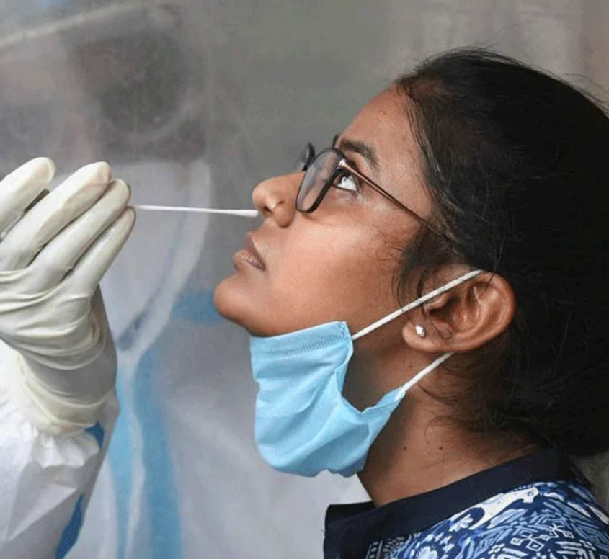
Learn to Return Program COMPONENTS
On-site BinaxNOW Antigen Testing (same day results)
Mail out Curative PCR testing (results in 48-72 hours)
Screening testing for athletes per WIAA guidance
This Photo by Unknown Author is licensed under CC BY

Slide 3
SCHOOL BASED TESTING CAN . . .
Give insight into virus prevalence in the school community
Reduce anxiety of returning staff
Bolster inadequate community access to testing
Ensure nobody is quarantined because they can’t find a test
Reduce lost learning days
Prevent in-school transmission of COVID-19
Help schools stay open

Slide 4
SUPPORT FROM LEARN TO RETURN PROGRAM
Free test kits & processing
Funding to support staff conducting the testing
Funded through July 2022
Testing parent permission forms
Technical assistance
Training for staff on conducting testing

Slide 5
Mitigation strategies In our safety plan
SYMPTOM MONITORING & SICK KIDS @ HOME
CONTACT TRACING
VOLUNTARY TESTING
MASKING & PHYSICAL DISTANCING
This Photo by Unknown Author is licensed under CC BY-NC

